Slide 1
Learning Lunch
June 2018

Slide 2
Liz & Jenn: Supervisory Essentials: Managing People and Leading Teams
Event: Supervisory skills training at the Support Center
Why We Attended: To improve our managerial skills as new supervisors
What We Learned:
- All techniques are useful in different situations, including micromanaging.
In order for delegation to be effective the supervisor needs to explain why the task is being delegated.
In giving feedback, the sandwich method isn’t universally effective.
What was surprising: To see how our background in supervising volunteers translated into managing employees.
What we will use: To be more explicit in giving feedback about the behavior and what change needs to happen.

Slide 3
Gabe: Internship Management
Event: Kiwi Partners - Internship Roundtable
Why I Attended: Connect with local non profit leaders to share ideas and challenges related to volunteerism
What I Learned:
  Changes to DOL internship laws
  Paid Internships can attract more qualified candidates of diverse backgrounds
  Importance of training mid-high level staff members in supervising volunteers/interns
What was surprising: Challenges that growing non profits face related to volunteer management
What I will use: Identify critical areas of the volunteer-internship program that require additional support

Slide 4
Joanna: Online Giving
Effectively Communicating with Donors
Why I Attended: To better secure donations and retain donors via our online donation page
What I Learned (top 3)
Less is more
Donors want to be the heroes- more them less us
Donors on average give more via a monthly giving campaign- the ask to join is most effective when the ask is made directly after an initial gift
What was surprising: Make another ask immediately
What I will use:
New Online donation page
We have implemented a plan to reach out to donors who have given $100 or less to SDM to join our monthly giving program

Slide 5
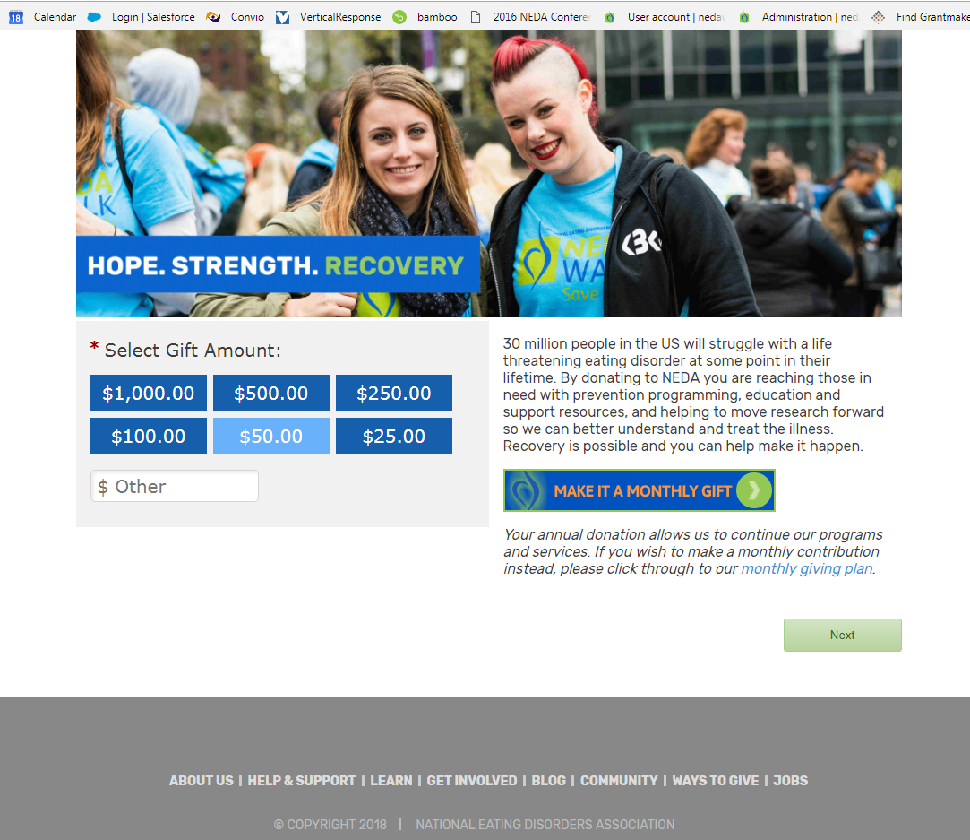
Updated Donation Page
Brought to you by Tom!

Slide 6
Bri: Fundraising and Marketing
Event: Blackbaud Fundraising & Marketing Summit on 5/11/2018
Why I Attended: Previously attended a similar summit by Blackbaud
What I Learned (top 3):
1) Video is the most important content type.
2) 80% of mobile users will abandon a site after one bad experience.
3) Being more authentic leads to higher engagement and more success than being more clever.
What was surprising: The increase in engagement that other non-profits have experienced through using video as a marketing tool.
What I will use: The Hero’s Journey

Slide 7
Connor: Examining and Engaging Gen Z
Event: Engaging Gen Z Webinar
Why I Attended: Relevant to Devo, and relevant to how the world will change in the next 5 years.
What I Learned (top 4)
Digital Natives – Growing Up, Social Media, Influencers
Entrepreneurial – Incentive-Driven, Multi-taskers,
Global Citizen vs. Global Spectator
Authenticity
What was surprising:
The Future - College Affiliation and Work place tendencies
What I will use:
Tools to better engage during our next virtual ask or virtual campaign.

Slide 8
Liz: Addiction Policy and Interventions
Event: It's Complicated: Addiction Policy and Interventions at Columbia University School of Social Work
Why I Attended: Motivational interviewing (MI) training and a better understanding of substance abuse (co-morbid with EDs)
What I Learned (top 3)
Drug policy in the US- prevents access to care (EDs and addiction)
Minority populations and the need for providers with high cultural competencies (our tx directory)
How motivational interviewing changed the authoritative approach in clinical work
What was surprising: Stages of change - pejorative (labeling people)
What I will use: Emphasis on barriers to care and diversity in our training and more practice on MI techniques in role play trainings

Slide 9
Lauren: NEDAcon Philadelphia
What I Learned (top 3)
- Marginalized communities
- Engagement of families
- Size diversity
What was surprising:
- Campus awareness – disability, food sensitivity, etc.
- Privilege awareness – context is important
What I will use:
Data/feedback for NEDAcon Houston and Seattle!

Slide 10
Claire: NEDA and SAMHSA
Event: SAMHSA (Substance Abuse and Mental Health Services Administration) Meeting of Eating Disorders Experts
Why I Attended: To represent NEDA & the patient advocacy community
What I Learned:
1. Centers of Excellence for bariatric surgery could help to inform how the eating disorders field might fund and structure COEs
2. There’s a new source of funding
3. The National Registry of Evidence-Based Programs and Practices is being redesigned
What was surprising: Dr. Anita Everett, Chief Medical Officer of SAMHSA attended a portion of the meeting
What I will use: Working to prepare a TA center application. Each center receives an average of $745,000

Slide 11
Jess: STRIPED/Harvard Catalyst Symposium
Event: “Reimagining the Frontier of Public Health Approaches to Eating Disorders Prevention: Transdisciplinary, Translational, Transformative
Why I Attended: To learn more about the current state of the ED field
What I Learned (top 3)
Researcher Kirsten Davison said showed how people not knowing their weight status/BMI is protective for their health.
Dr. Vikram Patel: NYC MH Health Professionals>MH Pros in sub-Saharan Africa
Dr. Vikram Patel: Don’t let diagnosis/non diagnosis or access to service disrupt your ability to move left on the spectrum
What was surprising: How groundbreaking the BMI conversation was
What I will use: Focusing on #3 could make our content more accessible

Slide 12
Q & A

