Slide 1
Eating Disorders 101
www.NationalEatingDisorders.org
Helpline: myneda.org/helpline
Business Line: 212-575-6200
Notes:
Welcome to Eating Disorders 101. Thank you for attending!
This presentation will cover the causes, warning signs, symptoms, health consequences, and treatment information for eating disorders.
This slide deck was put together by the National Eating Disorders Association. If you have questions, visit their website at www.nationaleatingdisorders.org.
Some of the topics we’ll be covering may be difficult to hear about; please feel free to take a break at any time.

Slide 2

What Are Eating Disorders?
Life-threatening
Extreme emotions and behaviors surrounding weight, food & size
Biological, psychological & sociocultural factors
Notes:
There is a false belief that most people with eating disorders are privileged young white women. While eating disorders do affect young women, they also affect men, transgender people, people of color, older people, young children, people with disabilities, and people from every walk of life. Stereotyping eating disorders as exclusive to one group is a disservice to the diverse group of people who are affected by eating disorders, and perpetuates a stigma that prevents people from getting help.
Sources:
Hudson JI, Hiripi E, Pope HG Jr, and Kessler RC. (2007). The prevalence and correlates of eating disorders in the National Comorbidity Survey Replication. Biological Psychiatry, 61(3):348-58.

Slide 3

Who Do Eating Disorders Affect?
Notes:
Everyone. People of all genders, ages, races, religions, ethnicities, sexual orientations, body shapes, and weights can be affected.
As many as 20 million females and 10 million men will struggle with an eating disorder at some point in their lives.
High rates of co-occurring conditions (including anxiety, OCD, depression, substance use)

Slide 4
Biopsychosocial Disorders
Biological Factors:
  Family history
  History of dieting
  Type One (Insulin-dependent) Diabetes
  Genetic predisposition
Psychological Factors:
  Low self esteem
  Relationship with self
  Feelings of inadequacy
  Depression, anxiety, fear, or loneliness
Social Factors:
  Cultural norms that overvalue appearance
  Body dissatisfaction
  Drive for perceived ideal body type
  Historical trauma
  Weight stigma/bullying
Notes:
Eating disorders are complex, bio-psycho-social conditions, with multiple causes. Eating disorders arise from a combination of established social, psychological, biological, and interpersonal factors. While they may begin with preoccupations with food and weight, they are most often about much more than food. It is important to understand that the factors that contribute to eating disorders are complex and multifaceted; they are not simply about weight and they are certainly not choices.

Slide 5
The 9 Truths About
Eating Disorders
1. Many people with eating disorders look healthy, yet may be extremely ill.
2. Families are not to blame, and can be the patients’ and providers’ best allies in treatment.
3. An eating disorder diagnosis is a health crisis that disrupts personal and family functioning.
Notes:
While there are varying opinions about eating disorders, the field has agreed upon 9 truths that they want the public to know.
Sources:
Produced in collaboration with Dr. Cynthia Bulik, PhD, FAED and the Academy for Eating Disorders, along with other major eating disorder organizations (Families Empowered and Supporting Treatment of Eating Disorders, National Association of Anorexia Nervosa and Associated Disorders, National Eating Disorders Association, The International Association of Eating Disorders Professionals Foundation, Residential Eating Disorders Consortium, Eating Disorders Coalition for Research, Policy & Action, Multi-Service Eating Disorders Association, Binge Eating Disorder Association, Eating Disorder Parent Support Group, International Eating Disorder Action, Project HEAL, and Trans Folx Fighting Eating Disorders).
Learn more and download a PDF of the 9 Truths about Eating Disorders.

Slide 6
The 9 Truths About
Eating Disorders
4. Eating disorders are not choices, but serious biologically influenced illnesses.
5. Eating disorders affect people of all genders, ages, races, ethnicities, body shapes and weights, sexual orientations, and socioeconomic statuses.
6. Eating disorders carry an increased risk for both suicide and medical complications.

Slide 7
The 9 Truths About
Eating Disorders
7. Genes and environment play important roles in the development of eating disorders.
8. Genes alone do not predict who will develop eating disorders.
9. Full recovery from an eating disorder is possible. Early detection and intervention are important.

Slide 8
Warning signs, symptoms
& health consequences
An Overview to Eating Disorders

Slide 9
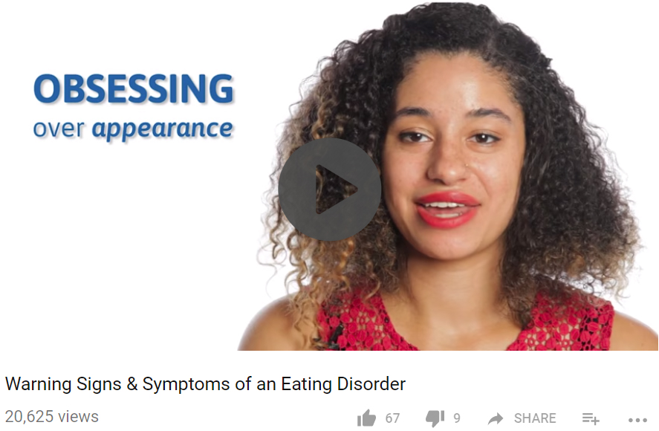
Warning Signs & Symptoms
https://www.youtube.com/watch?time_continue=133&v=nJMtReAg1DI

Slide 10
Common Warning Signs
EMOTIONAL/BEHAVIORAL
PHYSICAL
Weight loss, dieting, and control of food are primary concerns
Food rituals
Social withdrawal
Frequent dieting, body checking
Extreme mood swings
Noticeable weight fluctuations
Gastrointestinal complaints
Dizziness upon standing
Difficulty concentrating, sleeping
Issues with dental, skin, hair, and nail health
Notes:
The above list describes some of the general warning signs of an eating disorder. Detecting an eating disorder can be tricky, and a big indicator can be noticeable change in a person’s attitudes towards food and their body. While there are more specific signs depending on diagnosis, not everyone fits neatly into these categories. All eating concerns deserve immediate attention.

Slide 11
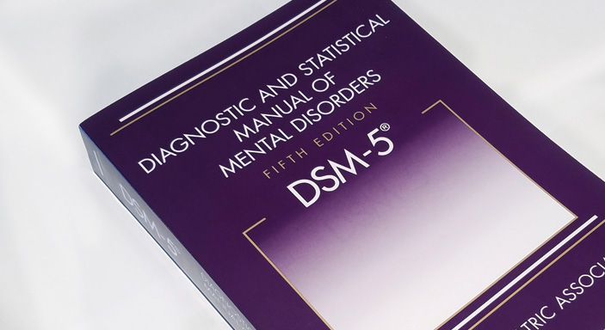
DSM-5 Diagnoses
Anorexia Nervosa | Bulimia Nervosa | Binge Eating Disorder | OSFED | ARFID
Notes:
Diagnoses include:
Anorexia Nervosa (AN)
Bulimia Nervosa (BN)
Binge Eating Disorder (BED)
Avoidant-Restrictive Food Intake Disorder (ARFID)
Other Specified Feeding or Eating Disorder (OSFED)
Unspecified Eating Feeding or Eating Disorder (UFED)
Rumination Disorder
Pica
Eating disorders are complex and some eating issues will not meet diagnostic criteria. All must be taken seriously.
The term eating disorders covers a variety of conditions. What they all have in common is that they involve extreme emotions, attitudes, and behaviors surrounding weight, food, and size.
Eating disorders are rooted in uniquely low self-esteem and disruption in one’s relationship with self.
Eating disorders are extremely serious and potentially life-threatening. They have both emotional and physical effects, and they can affect anyone, regardless of gender, age, race, or any other descriptor.
The eating disorders we will be talking about are anorexia, bulimia, binge eating disorder, avoidant-restrictive food intake disorder, and other specified feeding or eating disorder. Please keep in mind that this list is not exhaustive, and many of these conditions have variations, such as atypical anorexia. We won’t be able to cover every eating disorder but we do encourage you to look into them further; you can visit the NEDA website for more information.

Slide 12
Anorexia Nervosa (AN)
Characterized primarily by self-starvation and excessive weight loss
Symptoms include:
  Inadequate food intake leading to a weight that is clearly too low
  Disturbance in the experience of body weight or shape
  Intense fear of weight gain, obsession with weight, and persistent behavior to prevent weight gain
  Inability to appreciate the severity of the situation
Notes:
Anorexia nervosa is an eating disorder characterized by weight loss (or lack of appropriate weight gain in growing children); difficulties maintaining an appropriate body weight for height, age, and stature; and, in many individuals, distorted body image. People with anorexia generally restrict the number of calories and the types of food they eat. Some people with the disorder also exercise compulsively, purge via vomiting and laxatives, and/or binge eat.
Anorexia can affect people of all ages, genders, sexual orientations, races, and ethnicities. Historians and psychologists have found evidence of people displaying symptoms of anorexia for hundreds or thousands of years.
Although the disorder most frequently begins during adolescence, an increasing number of children and older adults are also being diagnosed with anorexia. You cannot tell if a person is struggling with anorexia by looking at them. A person does not need to be emaciated or underweight to be struggling. Studies have found that larger-bodied individuals can also have anorexia, although they may be less likely to be diagnosed due to cultural prejudice against fat and obesity.
DIAGNOSTIC CRITERIA
To be diagnosed with anorexia nervosa according to the DSM-5, the following criteria must be met:
Restriction of energy intake relative to requirements leading to a significantly low body weight in the context of age, sex, developmental trajectory, and physical health.
Intense fear of gaining weight or becoming fat, even though underweight.
Disturbance in the way in which one's body weight or shape is experienced, undue influence of body weight or shape on self-evaluation, or denial of the seriousness of the current low body weight.
Even if all the DSM-5 criteria for anorexia are not met, a serious eating disorder can still be present. Atypical anorexia includes those individuals who meet the criteria for anorexia but who are not underweight despite significant weight loss. Research studies have not found a difference in the medical and psychological impacts of anorexia and atypical anorexia.
WARNING SIGNS & SYMPTOMS OF ANOREXIA NERVOSA
Emotional and behavioral
Dramatic weight loss
Dresses in layers to hide weight loss or stay warm
Is preoccupied with weight, food, calories, fat grams, and dieting
Refuses to eat certain foods, progressing to restrictions against whole categories of food (e.g., no carbohydrates, etc.)
Makes frequent comments about feeling “fat” or overweight despite weight loss
Complains of constipation, abdominal pain, cold intolerance, lethargy, and/or excess energy
Denies feeling hungry
Develops food rituals (e.g., eating foods in certain orders, excessive chewing, rearranging food on a plate)
Cooks meals for others without eating
Consistently makes excuses to avoid mealtimes or situations involving food
Expresses a need to “burn off” calories taken in
Maintains an excessive, rigid exercise regimen – despite weather, fatigue, illness, or injury
Withdraws from usual friends and activities and becomes more isolated, withdrawn, and secretive
Seems concerned about eating in public
Has limited social spontaneity
Resists or is unable to maintain a body weight appropriate for their age, height, and build
Has intense fear of weight gain or being “fat,” even though underweight
Has disturbed experience of body weight or shape, undue influence of weight or shape on self-evaluation, or denial of the seriousness of low body weight
Postpuberty female loses menstrual period
Feels ineffective
Has strong need for control
Shows inflexible thinking
Has overly restrained initiative and emotional expression
Physical
Stomach cramps, other non-specific gastrointestinal complaints (constipation, acid reflux, etc.)
Difficulties concentrating
Abnormal laboratory findings (anemia, low thyroid and hormone levels, low potassium, low blood cell counts, slow heart rate)
Dizziness
Fainting/syncope
Feeling cold all the time
Sleep problems
Menstrual irregularities—amenorrhea, irregular periods or only having a period while on hormonal contraceptives (this is not considered a “true” period)
Cuts and calluses across the top of finger joints (a result of inducing vomiting)
Dental problems, such as enamel erosion, cavities, and tooth sensitivity
Dry skin
Dry and brittle nails
Swelling around area of salivary glands
Fine hair on body (lanugo)
Thinning of hair on head, dry and brittle hair
Cavities, or discoloration of teeth, from vomiting
Muscle weakness
Yellow skin (in context of eating large amounts of carrots)
Cold, mottled hands and feet or swelling of feet
Poor wound healing
Impaired immune functioning
HEALTH CONSEQUENCES OF ANOREXIA NERVOSA
In anorexia nervosa’s cycle of self-starvation, the body is denied the essential nutrients it needs to function normally. Thus, the body is forced to slow down all of its processes to conserve energy, resulting in serious medical consequences.
The body is generally resilient at coping with the stress of eating disordered behaviors, and laboratory tests can generally appear perfect even as someone is at high risk of death. Electrolyte imbalances can kill without warning; so can cardiac arrest. Therefore, it’s incredibly important to understand the many ways that eating disorders affect the body.

Slide 13
Bulimia Nervosa (BN)
Characterized by binge eating and compensatory behaviors, such as self-induced vomiting, in an attempt to undo the effects of binge eating.
Symptoms include:
  Frequent episodes of consuming very large amounts of food followed by behaviors to prevent weight gain, such as vomiting, laxative abuse, and excessive exercise
  Feeling of being out of control during the binge-eating episodes
  Extreme concern with body weight and shape
  Most people are of a normal weight
Notes:
Bulimia is primarily characterized by binge eating and compensatory behaviors. Compensatory behaviors include anything meant to reverse the effects of the binge, such as vomiting, laxative abuse, and excessive exercise. Concern with body weight and shape and feeling out of control during the binges are also symptoms. Most people struggling with bulimia appear to be of an average weight. It’s important to keep in mind that you cannot tell if someone is struggling with an eating disorder based on weight alone.
Warning signs of BN:
Frequent trips to bathroom after meals
Excessive, rigid exercise regimen; compulsive need to “burn off” calories taken in
Discoloration or staining of the teeth
Withdrawal from usual friends and activities
Continued exercise despite injury
Calluses on the back of hands and knuckles from self-induced vomiting
Health consequences of BN: The recurrent binge-and-purge cycles of bulimia nervosa can affect the entire digestive system and lead to electrolyte and chemical imbalances in the body that affect the heart and other major organ's functionality. One health consequence of bulimia nervosa is electrolyte imbalance leading to an irregular heartbeat and possible heart failure and death. These imbalances are caused by dehydration and loss of potassium, sodium, and chloride from the body as a result of purging behaviors. Other potential health consequences are gastric rupture during periods of binging, inflammation and possible rupture of the esophagus from frequent vomiting, tooth decay and staining from the stomach acids released during vomiting, chronic irregular bowel movements and constipation as a result of laxative abuse, and calluses on hands and knuckles from self-induced vomiting.

Slide 14
Binge Eating Disorder (BED)
Characterized by recurrent binge eating without the regular use of compensatory measures to counter the binge eating.
Symptoms include:
  Indications that the binge eating is out of control, such as eating when not hungry, eating to the point of discomfort, or eating alone because of shame about the behavior
  Feelings of strong shame or guilt regarding the binge eating
Notes:
Binge eating disorder, or BED, is characterized by sessions of binge eating. It differs from bulimia in that there is no compensatory behavior like purging. An important component of BED is that the person feels out of control during the binge, and distressed following it. BED is the most common eating disorder in the United States, and it’s often misunderstood as just overeating. It’s important to know that BED is not a choice, and it has a significant psychological impact on the person suffering.
A person struggling with BED can be of any weight or size, and you cannot tell if someone has BED just by looking at them. There is a correlation between BED and weight gain, and many of the physical effects of BED are similar to those of obesity. Still, it is important to remember that we are built differently based on a variety of factors. Our society perceives “thinness” as a positive quality, stigmatizing those who are not perceived as having the right body shape. Challenging this perception is an important step in creating a more inclusive culture.
Warning signs of BED:
Secretive about eating or binge episodes
Repeated episodes of dieting or attempts at weight loss
Large amounts of food may be missing from pantry or found in trash
Larger than normal amounts of money spent on food
Secret stashes of food or empty wrappers
Health consequences of BED:
Musculoskeletal problems
Gallbladder disease
High blood pressure; high cholesterol; heart disease
Type II diabetes

Slide 15
Avoidant-Restrictive Food Intake Disorder (ARFID)
Characterized by lack of interest in food, fears of negative consequences of eating, and selective or picky eating.
Symptoms include:
  Reduced food intake and frequent complaints of bodily discomfort with no apparent cause
  Lack of appetite or interest in food, with a range of preferred foods narrowing over time
Notes:
Avoidant-restrictive food intake disorder (ARFID) is an eating disorder that can appear as extremely picky eating. Those struggling may demonstrate a lack of interest in food and experience unexplained bodily discomfort. The limited range of “acceptable” foods narrows over time.
Warning signs of ARFID:
Restricted or reduced food intake
Frequent complaints about bodily discomfort with no organic cause
Lack of appetite or interest in food
Fear of negative effects of eating food (e.g., choking, vomiting)
Inability or reluctance to eat in front of others
Picky eating that is unresolved by late childhood
Health consequences of ARFID: Food restriction and lack of variety associated with ARFID may lead to severe nutritional deficiencies. Some of the potential health consequences of ARFID may include failure to thrive, which means not meeting expected levels of growth, anemia, weight loss, gallbladder disease, and malnutrition, characterized by dry hair, hair loss, brittle nails, difficulty concentrating, and Osteoporosis or osteopenia (reduction in bone density).

Slide 16
Other Specified Feeding or
Eating Disorder (OSFED)
A feeding or eating disorder that causes significant distress or impairment, but does not meet the criteria for another feeding or eating disorder.
Atypical Anorexia Nervosa: criteria for AN met but weight is not low
Subthreshold Bulimia Nervosa: criteria for BN met but with less frequent behaviors
Subthreshold Binge Eating Disorder: criteria for BED met but occurs at a lower frequency
Purging Disorder: purging without binge eating
Night Eating Syndrome: excessive nighttime food consumption
Notes:
Other specified feeding or eating disorder (OSFED) is a broad category. It includes conditions that do not meet the criteria for anorexia, bulimia, etc., but still cause significant distress. For example, in atypical anorexia nervosa all of the criteria for anorexia is met, but the patient’s weight is not low. The self-starvation and disordered thinking are psychologically and physically destructive and must still be addressed. It is important that OSFED is recognized on par with other eating disorders, and that its seriousness is not underestimated.
Warning signs and health consequences of OSFED: Warning signs and health consequences of OSFED are more difficult to pinpoint, as it includes a number of conditions. Watch out for all of the signs already listed. The most important thing to look out for is attitudes about food and weight that conflict with a productive and satisfying life.
Increased isolation, depression, or irritability
Compulsive or obsessive exercising

Slide 17
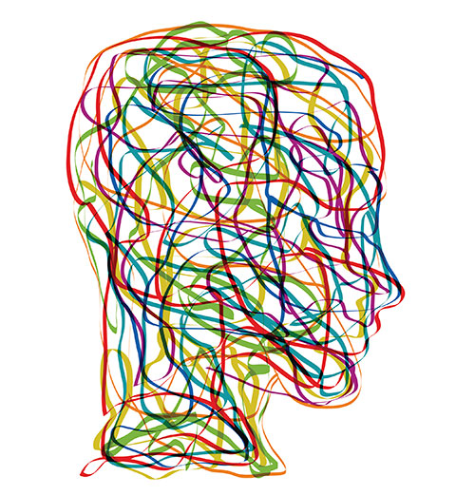
Common Comorbidities
Depression
Anxiety
OCD
Alcohol & substance use
Self-harm
PTSD
Notes:
Many of those who struggle with eating disorders have a co-occurring condition, such as anxiety, substance abuse, obsessive-compulsive disorder, depression, or post-traumatic stress disorder. All conditions should be identified and treated by someone with expertise in both eating disorders and any co-occurring conditions. Severe eating disorders affect people emotionally and looks like it can mimic other diagnoses which leads to misdiagnoses.
In a clinical setting, physician assistants may notice eating disorder symptoms that increase the presence of common comorbidities. For example, a patient with extreme body dissatisfaction, isolation, or uniquely low self esteem may meet the diagnostic criteria for depression. Similarly, a patient who is hyper-vigilant over their body and food and who has intrusive, preoccupying thoughts may have anxiety.
Comorbidities can intensify eating disorders symptoms and impact treatment (recovery, level of care, drop-out)
Most common comorbidities:
Mood disorders
Anxiety disorders
Substance abuse
Treatment should address co-existing conditions and eating disorders

Slide 18
Health Consequences
Cardiovascular (muscle loss, low or irregular heartbeat)
Gastrointestinal (bloating, nausea, constipation)
Neurological (difficulty concentrating, sleep apnea)
Endocrine (hormonal changes – estrogen, testosterone, thyroid)
Notes:
Eating disorders can affect every organ system in the body. The body is generally resilient at coping with the stress of eating disordered behaviors, and laboratory tests can generally appear perfect even as someone is at high risk of dying. Electrolyte imbalances can kill without warning; so can cardiac arrest. Therefore, it’s incredibly important to understand the many ways that eating disorders affect the body.
Cardiovascular system
Muscle loss due to calorie restriction
Risk of heart failure as blood pressure and heart rate drop
For physicians, the slow pulse of an athlete (due to a strong, healthy heart) can be confused with the slow pulse of an eating disorder (due to malnourishment).
Electrolyte imbalance can lead to an irregular heartbeat and possibly heart failure and death. The electrolyte potassium plays an important role in helping the heart beat and muscles contract, but is often depleted by purging.
Gastrointestinal system
Slowed digestion known as gastroparesis. Food restriction and/or purging by vomiting interferes with normal stomach emptying and the digestion of nutrients, which can lead to:
Stomach pain and bloating
Nausea and vomiting
Blood sugar fluctuations
Blocked intestines from solid masses of undigested food
Bacterial infections
Feeling full after eating only small amounts of food
Constipation, which can have several causes:
Inadequate nutritional intake, which means there’s not enough in the intestines for the body to try and eliminate
Long-term inadequate nutrition can weaken the muscles of the intestines and leave them without the strength to propel digested food out of the body
Laxative abuse can damage nerve endings and leave the body dependent on them to have a bowel movement
Binge eating can cause the stomach to rupture, creating a life-threatening emergency.
Vomiting can wear down the esophagus and cause it to rupture, creating a life-threatening emergency.
Frequent vomiting can also cause sore throats and a hoarse voice.
When someone makes themselves vomit over a long period of time, their salivary (parotid) glands under the jaw and in front of the ears can get swollen. This can also happen when a person stops vomiting.
Both malnutrition and purging can cause pancreatitis, an inflammation of the pancreas. Symptoms include pain, nausea, and vomiting.
Neurological
The brain consumes up to one-fifth of the body’s calories. Dieting, fasting, self-starvation, and/or erratic eating means the brain isn’t getting the energy it needs, which can lead to obsessing about food and difficulties concentrating.
Extreme hunger or fullness at bedtime can create difficulties falling or staying asleep.
The body’s neurons require an insulating, protective layer of lipids to be able to conduct electricity. Inadequate fat intake can damage this protective layer, causing numbness and tingling in hands, feet, and other extremities.
Neurons use electrolytes (potassium, sodium, chloride, and calcium) to send electrical and chemical signals in the brain and body. Severe dehydration and electrolyte imbalances can lead to seizures and muscle cramps.
If the brain and blood vessels can’t push enough blood to the brain, it can cause fainting or dizziness, especially upon standing.
Individuals of higher body weights are at increased risk of sleep apnea, a disorder in which a person regularly stops breathing while asleep.
Endocrine
Many hormones needed by the body are made with fat and cholesterol we eat. Without enough fat and calories in the diet, levels of hormones can fall, including:
Sex hormones estrogen and testosterone
Thyroid hormones
Lowered sex hormones can cause menstruation to fail to begin, to become irregular, or to stop completely. This can significantly increase bone loss (known as osteopenia and osteoporosis) and the risk of broken bones and fractures.
Reduced resting metabolic rate, a result of the body’s attempts to conserve energy.
Over time, binge eating can potentially increase the chances that a person’s body will become resistant to insulin, a hormone that lets the body get energy from carbohydrates. This can lead to type 2 diabetes.
Without enough energy to fuel its metabolic fire, core body temperature will drop and hypothermia may develop.
Starvation can cause high cholesterol levels, although this is NOT an indication to restrict dietary fats, lipids, and/or cholesterol.
Other
Low caloric and fat consumption can cause dry skin, and hair to become brittle and fall out.
To conserve warmth during periods of starvation, the body will grow fine, downy hair called lanugo.
Severe, prolonged dehydration can lead to kidney failure.
Inadequate nutrition can decrease the number of certain types of blood cells.
Anemia develops when there are too few red blood cells or too little iron in the diet. Symptoms include fatigue, weakness, and shortness of breath.
Malnutrition can also decrease infection-fighting white blood cells.
Sources:
Brown, CA and Mehler, PS. Medical complications of self-induced vomiting. Eating Disorders. 2013;21(4):287-94.
Brown, CA and Mehler, PS. Successful “Detoxing” From Commonly Utilized Modes of Purging in Bulimia Nervosa. Eating Disorders. 2012; 20(4): 312-20.
Mehler, PS and AE Anderson. Eating Disorders. Baltimore: Johns Hopkins UP, 2010. Print.
Mitchell, J. E., & Crow, S. (2006). Medical complications of anorexia nervosa and bulimia nervosa. Current Opinion in Psychiatry, 19(4), 438-443

Slide 19
Serious, Potentially
Fatal Illnesses
Eating disorders have the second highest mortality rate of all mental health disorders, surpassed only by opioid addiction.
Risk of death from suicide or medical complications is markedly increased for individuals with eating disorders.
A study on BN and EDNOS found elevated mortality risks similar to those for AN, despite being sometimes viewed as “less severe”
Notes:
Eating disorders have the second highest mortality rate of all mental health disorders, surpassed only by opioid addiction. The numbers underscore that eating disorders must be treated as serious illnesses. People can and do recover; acknowledging the seriousness of eating disorders and the importance of recovery can be a first step in that process. While the death rate varies by study, research analysis underscores the severity and public health significance of all types of eating disorders.
Crow and colleagues studied 1,885 individuals with anorexia nervosa (N=177), bulimia nervosa (N=906), or eating disorder not otherwise specified (N=802) over 8 to 25 years.
The investigators used computerized record linkage to the National Death Index, which provides vital status information for the entire United States, including cause of death extracted from death certificates.
Crow and colleagues found that crude mortality rates were 4.0% for anorexia nervosa, 3.9% for bulimia nervosa, and 5.2% for eating disorder not otherwise specified.
Sources:
Arcelus, J., Mitchell, A.J., Wales, J., & Nielsen, S. (2011). Mortality Rates in Patients with Anorexia Nervosa and Other Eating Disorders. Archives of General Psychiatry, 68(7), 724–731.
Chesney, E., Goodwin, G. M., & Fazel, S. (2014). Risks of all-cause and suicide mortality in mental disorders: a meta-review. World Psychiatry, 13(2), 153-160.
https://www.ncbi.nlm.nih.gov/pmc/articles/PMC4102288/
Crow, SJ., Peterson, CB., Swanson, SA., Raymond, NC., Speckers, S., Eckert, ED., Mitchell, JE. (2009) Increased mortality in bulimia nervosa and other eating disorders. American Journal of Psychiatry, 166(12), 1342-1346.

Slide 20
Barriers to care
Self-identification & Weight Stigma

Slide 21
Barriers to Self Identification
Often an individual with an eating disorder does not believe they have a problem.
Many people with eating disorders look healthy, yet may be extremely ill.
Eating disorders are often viewed as a disease that only affects affluent, white women.
Notes:
We know that early intervention increases a person’s chances of full recovery from an eating disorder. Despite this, many people in the early stages of their eating disorder experience denial regarding their symptoms. This can be compounded by the fact that social stigma leads many people to believe that they could not be at-risk for an eating disorder.
Eating disorders can affect anyone, regardless of their gender or sex. Although eating disorders are more common in females, researchers and clinicians are becoming aware of a growing number of males and non-binary individuals who are seeking help for eating disorders. A 2007 study by the Centers for Disease Control and Prevention found that up to one-third of all eating disorder sufferers are male, and a 2015 study of US undergraduates found that transgender students were the group most likely to have been diagnosed with an eating disorder in the past year (Diemer, 2015). It’s currently not clear whether eating disorders are actually increasing in males and transgender populations or if more of those individuals who are suffering are seeking treatment or being diagnosed. Because physicians may have preconceptions about who eating disorders affect, their disorders have generally become more severe and entrenched at the point of diagnosis.

Slide 22
What is Weight Stigma?
Discrimination or stereotyping based on a person’s weight.
Risk factor for depression, body dissatisfaction, and low self-esteem.
Increases the risk of eating disorder symptoms.
Notes:
Weight stigma, also known as weight bias or weight-based discrimination, is discrimination or stereotyping based on a person’s weight. Weight stigma can increase body dissatisfaction, a leading risk factor in the development of eating disorders. The best-known environmental contributor to the development of eating disorders is the sociocultural idealization of thinness.
It is never acceptable to discriminate against someone based on their size, but shaming, blaming, and “concern trolling” happen everywhere – at work, school, in the home, and even at the doctor’s office. In fact, weight discrimination occurs more frequently than gender or age discrimination.
Despite its unfortunate prevalence, weight stigma is dangerous and can increase the risk for adverse psychological and behavioral issues, including depression, poor body image, and binge eating.

Slide 23
Weight Stigma in Healthcare
Research shows that healthcare providers, when talking to obese patients, tend to:
  Provide them with less health information
  Spend less time with them
  View them as undisciplined, annoying, and noncompliant with treatment.
Notes:
Victims of weight stigma report physicians and family members are the most common source of weight bias. Among family members, weight-based teasing and diet talk are linked to binge eating, weight gain, and extreme weight control behaviors. Weight bias in health care is another important concern.
Research shows that healthcare providers, when talking to obese patients, tend to:
Provide them with less health information
Spend less time with them
View them as undisciplined, annoying, and noncompliant with treatment.
THE PROBLEM WITH OBESITY PREVENTION CAMPAIGNS
Attention given to obesity and weight control has skyrocketed in recent years, ingraining words like "BMI," "obesity epidemic," and "diet" into our national vocabulary. Since the rise of national obesity prevention campaigns, the incidence of weight stigma has increased about 66%. Though efforts to combat obesity are well intentioned, the research is clear: overemphasizing weight can encourage disordered eating and have counterproductive effects.
Andreyeva T, Puhl RM, Brownell KD. Changes in perceived weight discrimination among Americans, 1995–1996 through 2004–2006. Obesity. 2008;16(5):1129–1134.
Puhl RM, King KM. Weight discrimination and bullying. Best Pract Res Clin Endocrinol Metab. 2013;27(2):117–127.

Slide 24

Do you have higher weight bias?
https://implicit.harvard.edu/implicit/takeatest.html
Notes:
You may take this self-assessment on a desktop or mobile device. For technical support, please visit: https://implicit.harvard.edu/implicit/help.html.

Slide 25
Seeking treatment
Help is Available!

Slide 26
Serious, Life-Threatening,
& Treatable
Eating disorders are not fads or phases, and they have the second highest mortality rate of any psychiatric disorder, surpassed only by opioid addiction.
Serious effects on health, productivity, and relationships
Early intervention increases likelihood of a full recovery.
Notes:
Eating disorders have the second highest mortality rate of all mental health disorders, surpassed only by opioid addiction.
While the seriousness of eating disorders should not be underestimated, eating disorders are not hopeless. Treatment is available and recovery is possible. Early intervention is vital; the earlier a person seeks treatment, the greater the likelihood of physical and emotional recovery. Detecting and treating eating disorders as soon as possible can save lives.
Help is available!
Various online resources are playing an important role in helping to those who are aware of their eating disorder, as well as identifying those who may not be aware they have an eating disorder or may be at risk.

Slide 27
Eating Disorders Treatment
Intervention
Professional Treatment
Ongoing Support
Recovery
Notes:
Eating disorder treatment and recovery involves intervention, professional treatment, and ongoing support.
Early diagnosis and intervention significantly enhance recovery.
Following intervention, professional treatment should be the first step; eating disorders require the care of a trained professional with expertise in the treatment of eating disorders.
Ongoing support from friends and family is vital. These are complex illnesses, and compassionate support throughout the treatment process is essential.
Remember that recovery is not a straight line, and everyone’s path will be different—one step forward and one step back is not unusual. Keep striving towards and respecting the recovery process.
Although more research in the field of eating disorders is needed, various evidenced-based treatment options are available.

Slide 28

Individualized Care
TREATMENT PROCESS
Initial assessment/diagnosis
Interview providers
Communicate with all involved
Develop a maintenance plan
Notes:
There is no one-size-fits-all path to treatment. Many parents find that meeting with a medical professional is a positive first step in determining what’s best for their family. They’ll want to identify both the type of treatment and the level of care that are appropriate. Because eating disorders have such wide-ranging effects on the brain and body, a team of treatment professionals is usually best. It’s important to communicate openly with everyone involved in treatment, particularly when moving from a more intensive type of treatment to a less restrictive one (e.g., leaving residential for outpatient treatment), and when developing an ongoing maintenance plan.
Initial assessment/diagnosis:
Meet with a medical professional.
Review different treatment modalities and approaches.
Determine level of care needed.
Interview providers:
Find the best fit for individual’s needs.
Recommended treatment involves a multidisciplinary team of professionals (e.g., therapist, nutritionist, psychiatrist, physician).
Communicate with all involved:
Connect with your insurance provider regarding coverage.
Read your full insurance policy in advance.
Communicate with the treatment team about how best to support your loved one.
Develop a maintenance plan:
Coordinate with treatment team to ensure ongoing treatment plan, particularly after stepping down care (e.g., leaving inpatient).
Support from loved ones is beneficial to sustaining recovery.

Slide 29

Levels of Care
  Inpatient
  Residential
  Partial hospitalization
  Intensive outpatient
  Outpatient
Notes:
Only a treatment professional can determine which level of care is appropriate for someone just beginning treatment. Determining the appropriate level of care takes into consideration the patient’s medical and psychological states.
Inpatient:
Patient is medically unstable (unstable/depressed vital signs, acute health risk, complicating co-occurring conditions)
Patient is psychiatrically unstable (rapidly worsening symptoms, suicidal)
Residential:
Patient is medically stable and requires no intensive medical intervention
Patient is psychiatrically impaired and unable to respond to partial hospital or outpatient treatment
Partial hospitalization:
Medically stable with impaired functioning (no immediate risk)
Needs daily assessment of physiologic and mental status
Psychiatrically stable but unable to function in normal situations
May engage in daily binge eating, purging, restricting, or other weight control techniques
Intensive outpatient/outpatient:
Patient is medically stable and no longer needs daily medical monitoring
Patient is psychiatrically stable, able to function in normal situations, and make progress towards recovery

Slide 30
Support & Resources
Where to Find Help

Slide 31
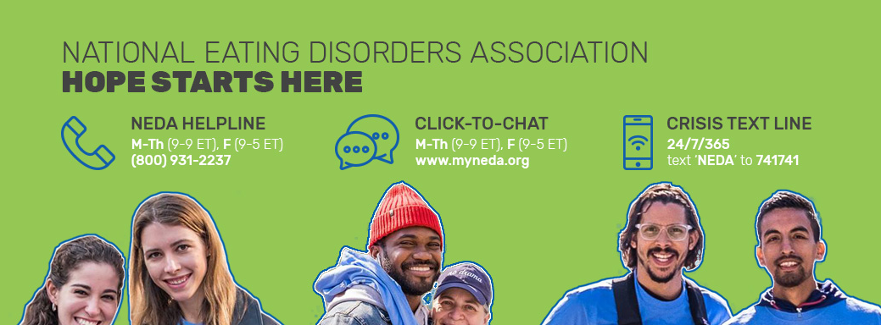
Helpline phone hours are Monday-Thursday from 11AM to 9PM ET, and Friday from 11AM to 5PM ET.
Helpline chat hours are Monday-Thursday from 9AM to 9PM ET and Friday 9AM to 5PM ET.
24/7 crisis support: text “NEDA” to 741741

Slide 32
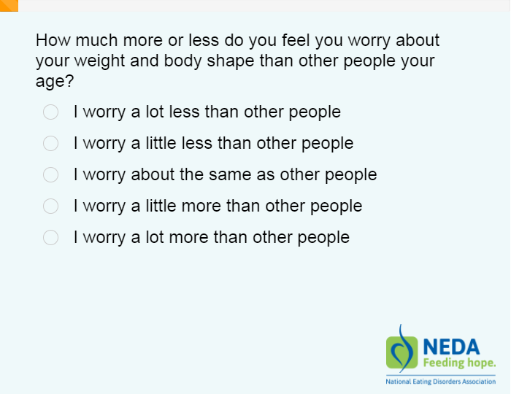
Eating Disorder Screening Tool
97% of participants identified as at-risk
Over 400,000 screenings taken from 2018-2019
Quick access to help
Notes:
Of the 177,000 screenings taken in 2019, 68% of those screened were under the age of 25 years old.
In 2019, 97% of all participants were identified as at risk for an eating disorder, and 97% of these at-risk contacts were not in treatment.
Additionally, with 25,000 calls, texts, emails, and messages to our Information and Treatment Option Helpline, 65% of those contacting NEDA were under the age of 25 years old
Participants who screen as “at risk” with be directed to NEDA’s Helpline and other resources to help.

Slide 33

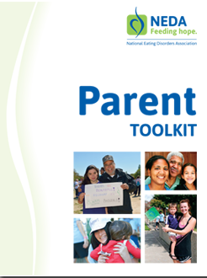
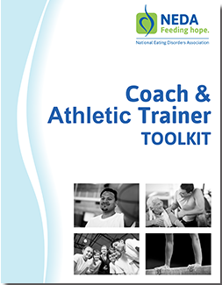
NEDA Toolkits
Notes:
NEDA Toolkits are free resources designed to educate on eating disorders.

Slide 34
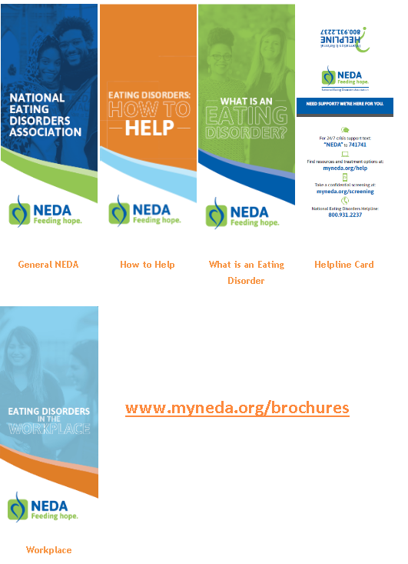
Brochures
Notes:
NEDA’s free, downloadable brochures are available at myneda.org/brochures.

Slide 35
How to Help
DO:
DON’T:
Learn as much as you can about eating disorders
Be honest and vocal about your concerns
Be caring and firm
Suggest they seek help from a physician and/or therapist
Be a good role model, practice what you preach
Place shame, blame, or guilt
Make rules or promises that you cannot or will not uphold
Give simple solutions
Invalidate their experience or try to convince
Give advice about weight, exercise, or appearance
Ignore or avoid the situation until it is severe or life-threatening
Notes:
If your student is struggling with an eating disorder, education is the first step.
NEDA’s Educator Toolkit (www.myneda.org/educator-toolkit) includes extensive information for those who are concerned about a student.

Slide 36

How to Help a Loved One
https://www.youtube.com/watch?v=fX1CFDtdgbY

Slide 37
Talking about Eating Disorders
KEEP IN MIND:
Don’t provide tips or play the numbers game.
Emphasize the seriousness of eating disorders without portraying them as hopeless.
Watch out for the appearance ideal.
Don't focus on images or descriptions of the body at its unhealthiest point.
Notes:
When eating disorders come up—whether you’re giving a presentation or just chatting with a friend—keep in mind a few guidelines to make sure you’re discussing them responsibly:
Don’t emphasize numbers or tips: “He took as many as X laxatives a day” can turn a well-intentioned story into a how-to guide.
Watch out for the appearance ideal, such as a societal or cultural focus on having a certain body type. Eating disorders are mental illnesses; they are not glamorous.
Emphasize the seriousness of eating disorders without portraying them as hopeless: Recovery can be a long, hard process, but it’s always worth it. Always encourage people to seek help for themselves or their loved ones.
Don’t focus on graphic images or descriptions of the body at its unhealthiest point: “At her lowest weight, she was only X pounds” could be interpreted as a challenge (“She’s X pounds and she’s still alive…I should lose more weight.”). Overemphasizing the physical aspects of eating disorders may also overshadow the fact that they are mental illnesses.

Slide 38

The Body Project
Train-the-trainer model
450+ trained
Repeatedly shown to effectively reduce body dissatisfaction, negative mood, unhealthy dieting, and disordered eating
2-hour experiential version available
Notes:
The Body Project is a evidence-based intervention program that provides a forum for college aged women and high school girls to confront unrealistic beauty ideals and engages them in the development of healthy body image.
Over a four-week period, participants critique the appearance ideal standard of female beauty in a series of verbal, written, and behavioral exercises. The program improves negative body image, reduces maladaptive dietary restraint, and reduced early stage eating disorder symptoms.
The Body Project is also only one of two programs that have been found to reduce the onset of eating disorders.
Data suggests that for every 100 high-risk young women who complete the Body Project intervention, there should be approximately nine fewer future cases of eating disorders (Stice, Marti, Spoor, Presnell, & Shaw, 2008)

Slide 39

The Body Project
“Now that I have done the Body Project, I have noticed that I see my body more positively now and I stay away from negative comments. I am also doing this with my family members and staff around me.”

Slide 40




Get Involved With NEDA!
To learn more, contact:
Business: (212) 575-6200
NEDA Helpline: myneda.org/helpline
Email: info@myneda.org

